Slide 1
SER 334 A Session
SI Session
Sunday, February 4th 2024
7:00 pm - 8:00 pm MST

Slide 2
{
Agenda
Critical Section & Solutions
Hardware Solutions
Peterson’s Solution
Mutexes
Semaphores
Monitors

Slide 3
SI Session Expectations
Thanks for coming to the SER 334 SI session. We have a packed agenda and we are going to try to get through as many of our planned example problems as possible. This session will be recorded and shared with others.
If after this you want to see additional examples, please visit the drop-in tutoring center.
We will post the link in the chat now and at the end of the session.
tutoring.asu.edu
Please keep in mind we are recording this session and it will be made available for you to review 24-48 hours after this session concludes.
Finally, please be respectful to each other during the session.

Slide 4

Interact with us:
Zoom Features
Zoom Chat
Use the chat feature to interact with the presenter and respond to presenter’s questions.
Annotations are encouraged

Slide 5
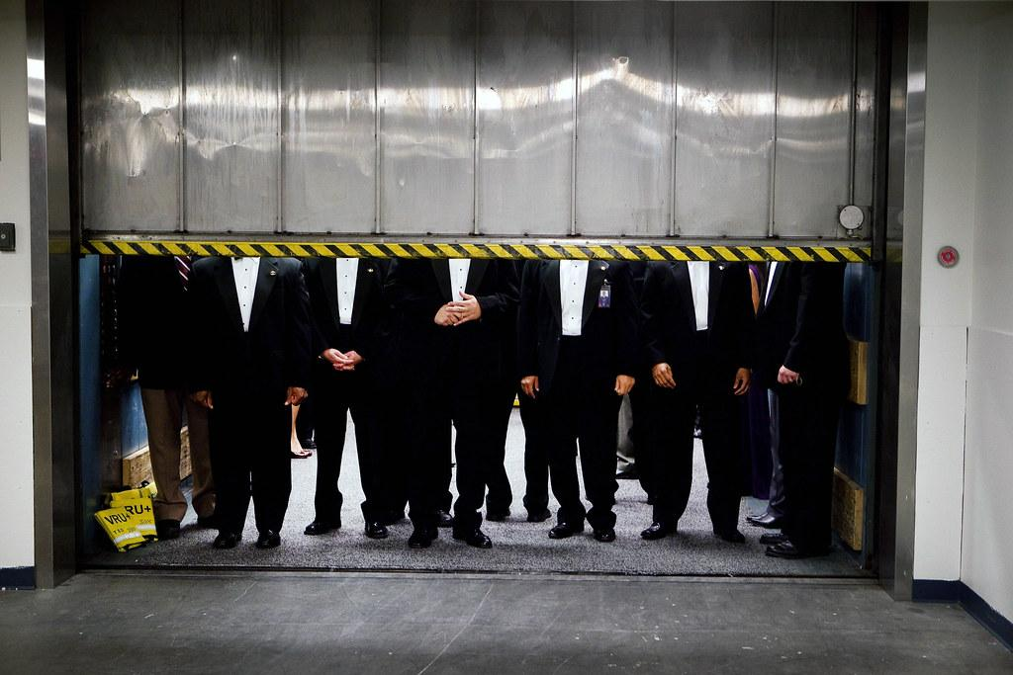
SER 334
Stepping on each other’s toes
Critical Section
What is the Critical Section?
Area of code where thread execution can impact other threads
Notes:
Threads step on each other

Slide 6
SER 334
Thead 1
Thead 2
Critical Section
Not just any action, actions that result in a state change or manipulate shared resources.
Thread 1 was in the process of performing an action, and Thread 2 jumped in the middle!
Deposit $100
Withdraw $50
Account Balance: $ 0.00

Slide 7
Race Condition
Starvation
Deadlock
SER 334
Critical Section
The solution needs to ensure…
Mutual Exclusion
Progress
Bounded Waiting Time
Notes:
Mutual exclusion - at no time should any two processes be executing code in the critical region (one at a time in danger zone)
Progress - if no process is in the critical region and some other process is ready to enter, it shall enter (no stranded processes)
Bounded Wait Time - once ready to enter the critical section, the process shall have a limited wait time (no process is stuck forever)

Slide 8
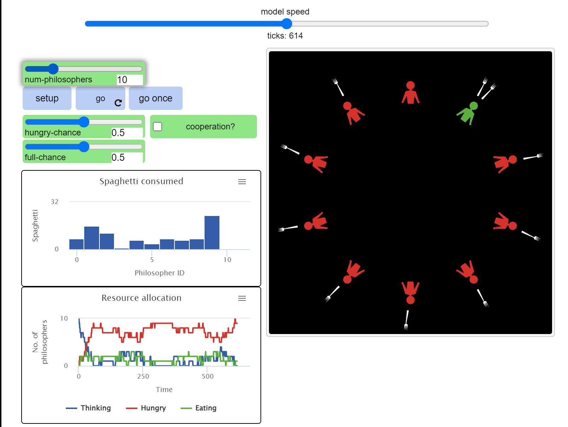
SER 334
Dining Philosophers
Critical Section
Race Condition
Deadlock
Starvation

Slide 9
SER 334
Critical Section Solutions
Peterson’s Solution
Synchronization Hardware
Mutex
Semaphore
Monitor

Slide 10
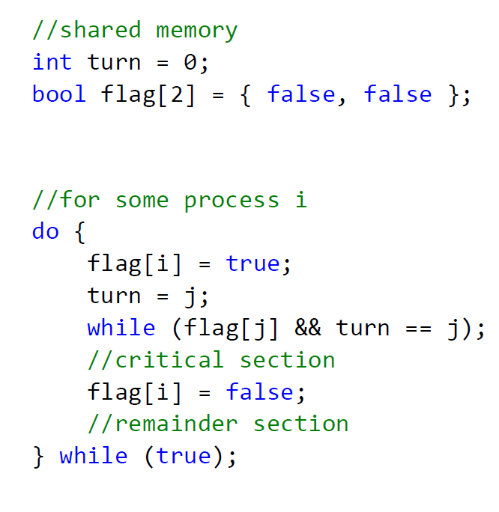
SER 334
Peterson’s Solution
Peterson’s Solution
I want to go

Slide 11

SER 334
Peterson’s Solution
I want to go
But you can go first…

Slide 12
SER 334
Peterson’s Solution
I want to go
But you can go first…
Wait for my turn

Slide 13
SER 334
Peterson’s Solution
I want to go
But you can go first…
Wait for my turn
Danger Zone

Slide 14
SER 334
Peterson’s Solution
I want to go
But you can go first…
Wait for my turn
Danger Zone
You can go now

Slide 15
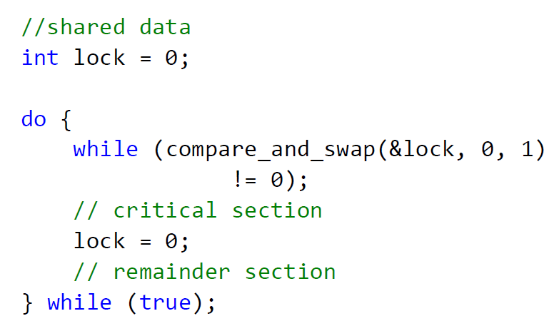
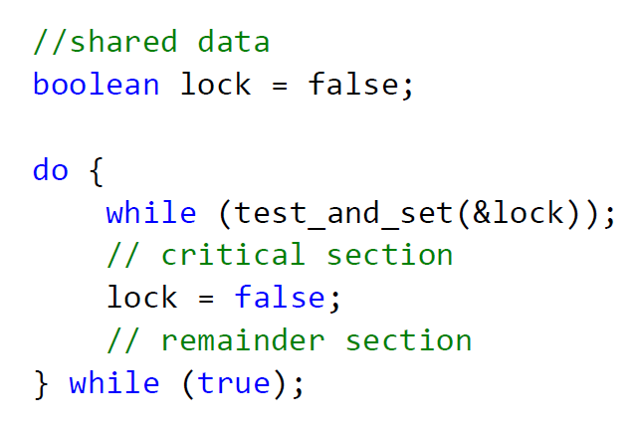
SER 334
Hardware that has special atomic actions
Synchronization Hardware
Synchronization Hardware
Expected
New Value
T → T : ⟳
F → T : ⤸
If lock is currently zero, set lock to 1

Slide 16
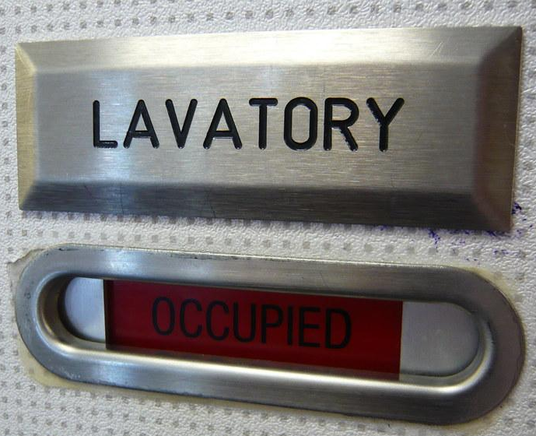
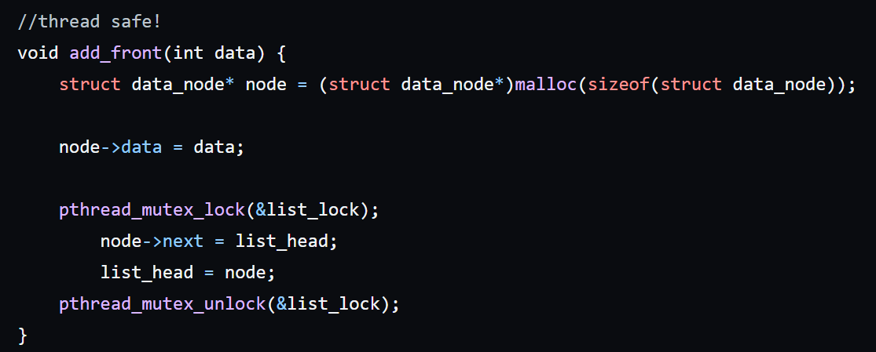
code_samples/M07_MutexBasics
SER 334
A Mutex is sort of like a lock on a door
Mutex
Lock the door behind you
Already Locked? → In use!
Unlock door as you leave

Slide 17

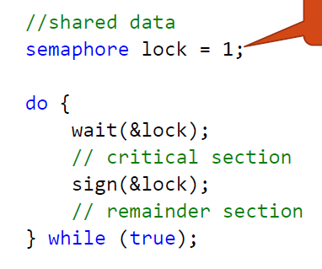
SER 334
Semaphores
What is the difference between a mutex and a semaphore?
Many stalls…
Wait in line for open stall
Unlock when leaving
Semaphores support more than one resource

Slide 18
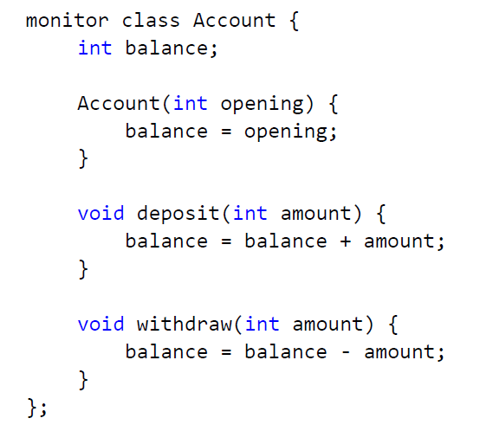
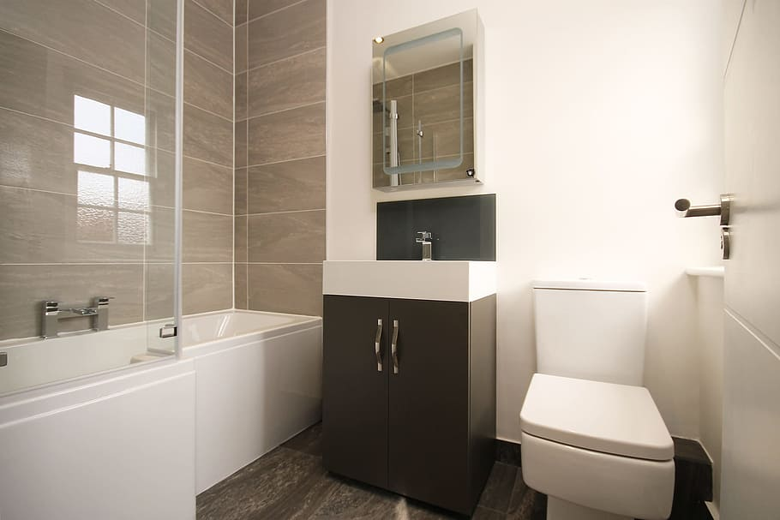
Monitor expands the concept to cover a class as a whole.
SER 334
Monitors
Only one process can execute within the class at one time
Deposit $100
Withdraw $50

Slide 19
Module 7 Sample
SER 334
4. [Acuña] Explain how it would be possible to have a situation where programs are making progress but do not have bounded waiting time.
Samples
Program
Remainder
Critical Section
Remainder
Notes:
Progress - no one in crit section & you want to enter? Enter.
Unbound wait time → does not complete or will try to complete for forever
**high priority process can jump in front!!

Slide 20
Module 7 Sample
SER 334
5. [Acuña] Consider the code for Peterson's Solution. Notice that part of the algorithm has been commented out. Explain how this changes it's functionality. Will it still solve the critical section problem? Explain.
Samples
//shared memory
int turn = 0;
bool flag[2] = { false, false };
//for some process i
do {
flag[i] = true;
turn = j;
while (flag[j] /* && turn == j */);
//critical section
flag[i] = false;
//remainder section
} while (true);

Slide 21
Module 7 Sample
SER 334
9. [Lisonbee] Given the following partially implemented code, implement the calls to mutex lock and unlock in the appropriate spots in the runner function to ensure that two threads don't write to the same index in the memory array.
Samples
int main() {
pthread_t threads[NUM_THREADS];
pthread_mutex_init(&lock, NULL);
for (int i = 0; i < NUM_THREADS; i++) {
pthread_create(threads[i], NULL, runner, (i * 7));
}
for (int i = 0; i < NUM_THREADS; i++) {
pthread_join(threads[i], NULL);
}
pthread_mutex_destroy(&lock);
return 0;
}
void* runner(void* arg) {
memory[counter] = *((int*)arg);
printf("Wrote %d at index %d\n", *((int*)arg), counter);
counter++;
pthread_exit(0);
}

Slide 22
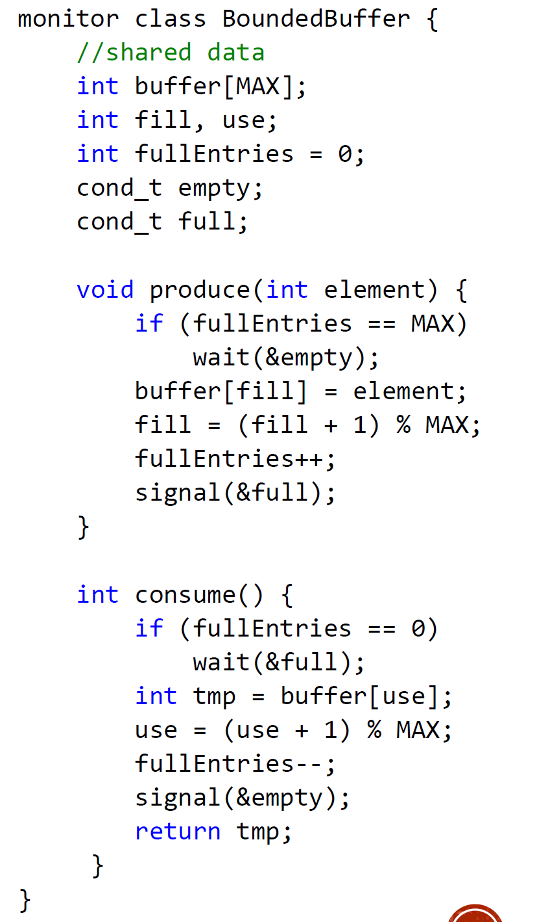
Producer/Consumer Visual
SER 334
Producer/Consumer

Slide 23
Module 8 Sample
SER 334
4. [Acuña] Consider the following solution to the producer consumer problem from Silberschatz.
This solution to the producer consumer problem with a bounded buffer requires three semaphores - can the problem be solved with less? Explain.
Samples
//shared data. [Operating Systems Concepts by Silberschatz.]
int n;
//also a buffer data structure
semaphore buf_mutex = 1;
semaphore empty = n;
semaphore full = 0
...

Slide 24
Module 8 Sample
6. [Lisonbee] The bounded buffer problem is a result of producing and consuming work asynchronously at different and/or variable rates. Provided below is are the producer and consumer functions used by a program.
Assume that the producer and consumer are running in parallel. In order to solve the bounded buffer problem demonstrated here, the appropriate calls to wait and signal need to be added. Rewrite the above code using wait and signal and initialize the 3 semaphores to the appropriate values (Note: you must use all three semaphores at least once in your calls to wait and signal).
SER 334
Samples
int data[15], i0 = 0, i1 = 0;
semaphore mutex = ... ;
semaphore empty = ... ;
semaphore full = ... ;
void producer() {
while (1) {
data[i0] = i0 * i0;
i0 = ++i0 % 15;
}
}
void consumer() {
while (1) {
printf("%d\n", data[i1]);
i1 = ++i1 % 15;
}
}

Slide 25
SER 334
Scratch Space

Slide 26
Upcoming Events
SI Sessions:
Monday, February 5th at 7:00 pm MST
Sunday, February 11th at 7:00 pm MST Cancelled - Good luck on Exam 2!
Monday, February 12th at 7:00 pm MST
Review Sessions:
Exam 2 Review: Thursday, February 8th 7:00 pm - 9:00 pm MST
Exam 3 Review: TBD

Slide 27

Questions?
Survey:
http://bit.ly/ASN2324

Slide 28


More Questions?
Check out our other resources!
tutoring.asu.edu
1-
2-
Click on ‘Go to Zoom’ to log onto our Online Tutoring Center.
Click on ‘View the tutoring schedule’ to see when tutors are available for specific courses.

Slide 29
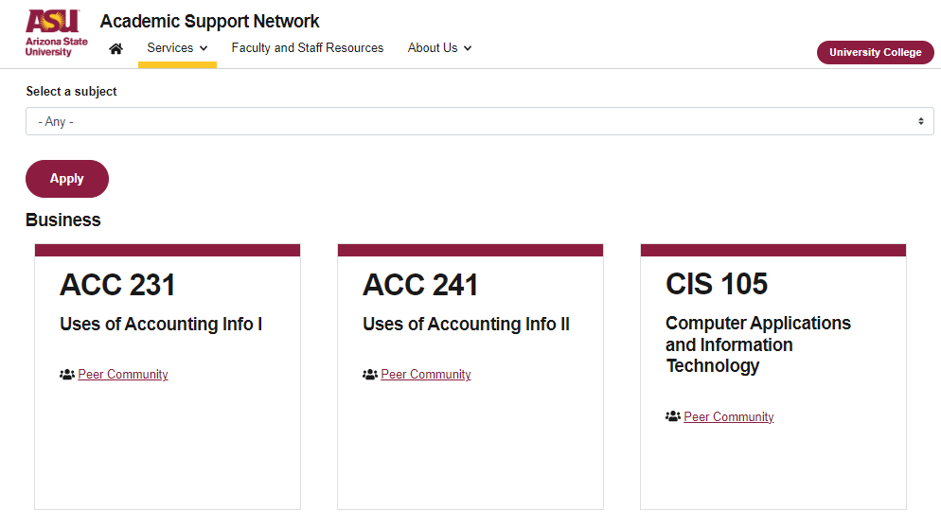

More Questions?
Check out our other resources!
tutoring.asu.edu/online-study-hub
Don’t forget to check out the Online Study Hub for additional resources!

Slide 30
Additional Resources
Course Repo
Course Discord
BMP File Format (Wiki)
Linux Kernel API
Bootlin - Linux Cross Referencer
Dining Philosophers Interactive
Producer/Consumer Visual

